Slide 1
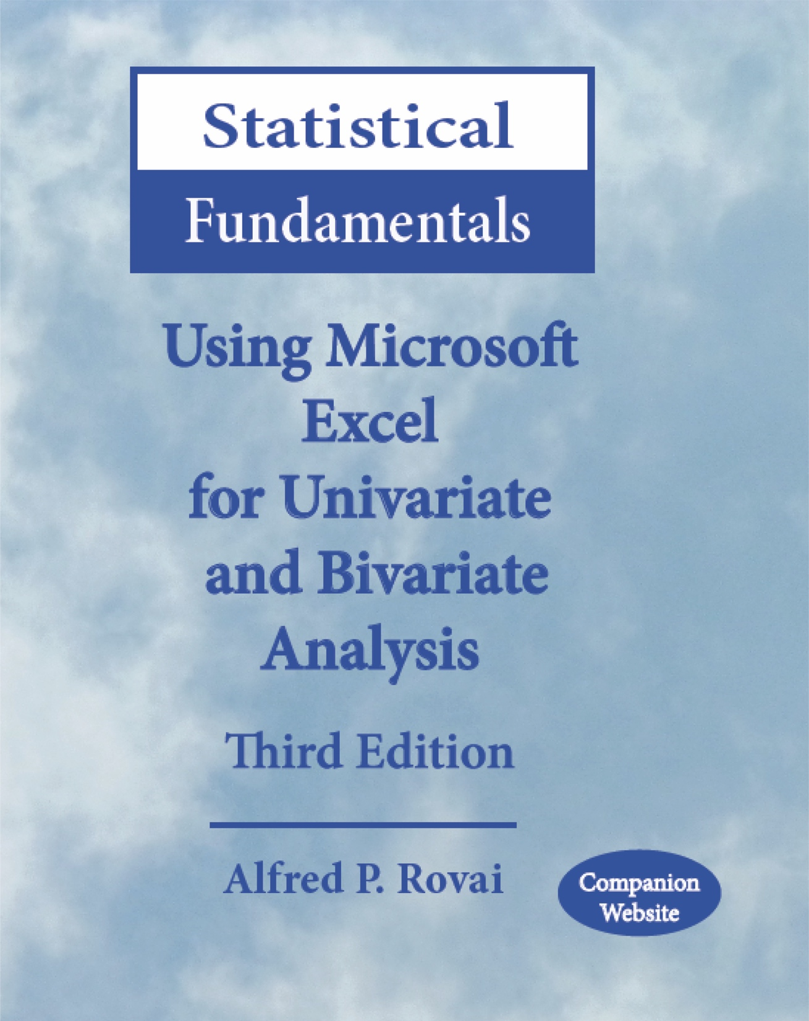
Statistical Fundamentals:
Using Microsoft Excel for Univariate and Bivariate Analysis
Alfred P. Rovai
Descriptive Statistics – Measures of Relative Position
PowerPoint Prepared by
Alfred P. Rovai
Microsoft® Excel® Screen Prints Courtesy of Microsoft Corporation.

Slide 2
Descriptive Statistics
Statistics
  Summary measures calculated for a sample dataset.
Parameters
  Summary measures calculated for a population dataset.
Used to describe variables
  Measures of central tendency, e.g., mean, median, mode
  Measures of dispersion, e.g., standard deviation, variance, range
  Measures of relative position, e.g., percentile, quartile
  Graphs and charts, e.g., scatterplot, column chart, histogram

Slide 3
Measures of Relative Position
Measures of relative position indicate how high or low a score is in relation to other scores in a distribution.
  Answers the question: Where is this value with respect to the other values in the population or in the sample?
A percentile (P) is a measure that tells one the percent of the total frequency that scored at or below that measure.
  The kth percentile (P_{k}) of a set of data is a value such that k percent of the observations are less than or equal to the value.
A quartile (Q) divides the data into four equal parts based on their statistical ranks and position from the bottom.
  Q₁ has 25% of the data at or below it.
  Q₂ (median) has 50% of the data at or below it; it is equal to the median.
  Q₃ has 75% of the data at or below it.
  Interquartile range (IQR) = Q₃ – Q₁; the range of the middle 50% of the data.
Percentiles and quartiles are cutoff scores and not ranges of values.
Standardized scores (e.g., z-scores).

Slide 4
Measures of Relative Position
Excel functions:
PERCENTILE.INC(array,k). Returns the kth percentile in a range of numbers.
QUARTILE.INC(array,quart). Returns the specified quartile, in a range of numbers.
Note: k = the percentile value in the range 0 to 1, inclusive; quart = 0 returns the minimum value, quart = 1 returns Q₁, quart = 2 returns Q₂ (median), quart = 3 returns Q₃, quart = 4 returns the maximum value.

Slide 5
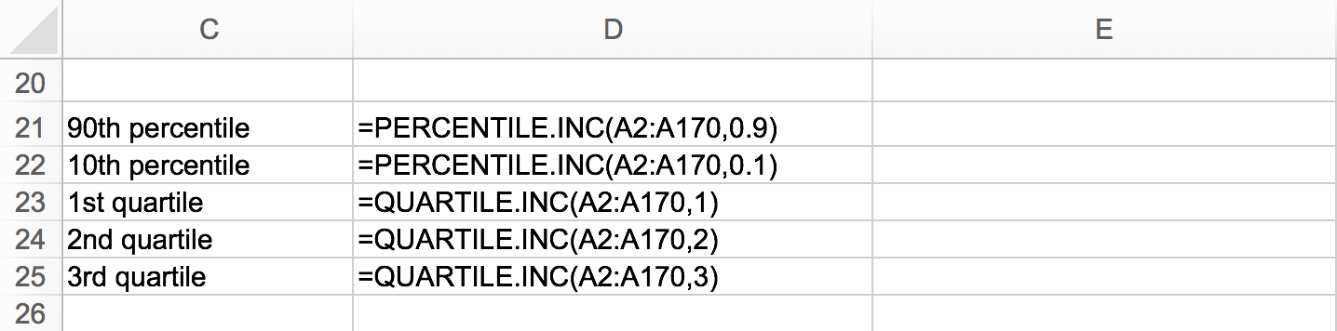
Calculating Measures of Relative Position
TASK
Enter the formulas in cells D12:D25 as shown on the worksheet to calculate P₉₀, P₁₀, Q₁, Q₂, and Q₃.

Slide 6
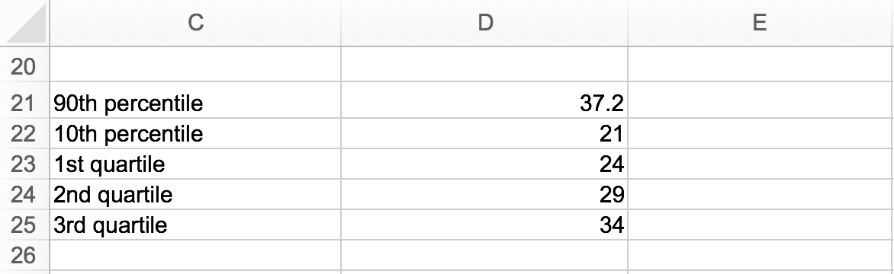
Calculating Measures of Relative Position
Excel displays percentiles and quartiles, as shown. These statistics can be interpreted as follows:
90% of c_community scores are at or below a score of 37.2
10% of c_community scores are at or below a score of 21
25% of c_community scores are at or below a score of 24
50% of c_community scores are at or below a score of 29
75% of c_community scores are at or below a score of 34
Note: interpretations assume c_community is normally distributed

Slide 7
z-Scores
A standard score is a general term referring to a score that has been transformed for reasons of convenience, comparability, etc.
The basic type of standard score, known as a z-score, is a measure of a score’s distance from the mean in standard deviation units. For example…
  If z = 0, it’s on the mean.
  If z = 1.5, it’s 1.5 standard deviations above the mean.
  If z = -1, it’s 1.0 standard deviations below the mean.
A z-score distribution is the standard normal distribution, N(0,1), with mean = 0 and standard deviation = 1. The formula for calculating z-scores from raw scores is
where X = raw score, $\overline{X}$ = raw score mean, and SD = raw score standard deviation.
Most other standard scores are linear transformations of z-scores, with different means and standard deviations. For example, T-scores, used in the Minnesota Multiphasic Personality Inventory (MMPI), have M = 50 and SD =10, and SAT scores have M = 500 and SD = 100.

Slide 8
Why z-Scores?
Transforming raw scores to z-scores facilitates making comparisons, especially when using different scales.
A z-score provides information about the relative position of a score in relation to other scores in a sample or population.
  A raw score provides no information regarding the relative standing of the score relative to other scores.
  A z-score tells one how many standard deviations the score is from the mean. It also provides the approximate percentile rank of the score relative to other scores. For example, a z-score of 1 is 1 standard deviation above the mean and equals the 84.1 percentile rank (50% of occurrences fall below the mean and 34.1% of the occurrences fall between 0 and 1; 50% + 34.1% = 84.1%).

Slide 9
Calculating z-Scores from Raw Scores
23 | 28.84 | -5.84 | 6.24 | -.94
22 | 28.84 | -6.84 | 6.24 | -1.10
33 | 28.84 | 4.16 | 6.24 | .67
19 | 28.84 | -9.84 | 6.24 | -1.58
A raw score of 23 equals a z-score of – .94, indicating both scores are .94 standard deviations below the mean.

Slide 10
Calculating Raw Scores from z-Scores
-.94 | 6.22 | -5.85 | 28.84 | 22.99
-1.10 | 6.22 | -6.84 | 28.84 | 22
.67 | 6.22 | 4.17 | 28.84 | 33.01
-1.58 | 6.22 | -9.83 | 28.84 | 19.01
Differences (±.01) in calculated raw scores and actual raw scores are the result of rounding.

Slide 11
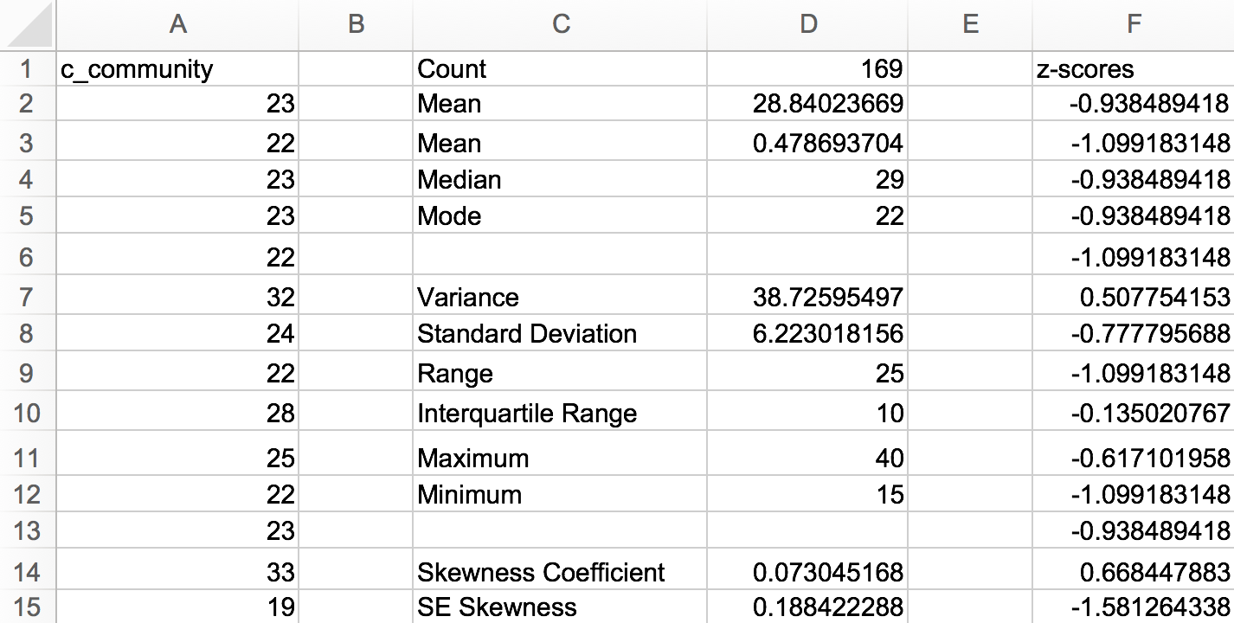
Open the dataset Motivation.xlsx.
Click the worksheet Descriptive Statistics tab (at the bottom of the worksheet).
File available at http://www.watertreepress.com/stats
TASK
Convert classroom community (c_community) raw scores into z-scores.

Slide 12
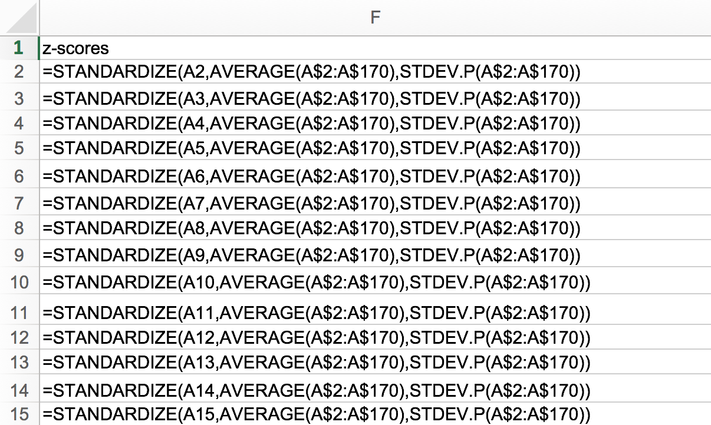
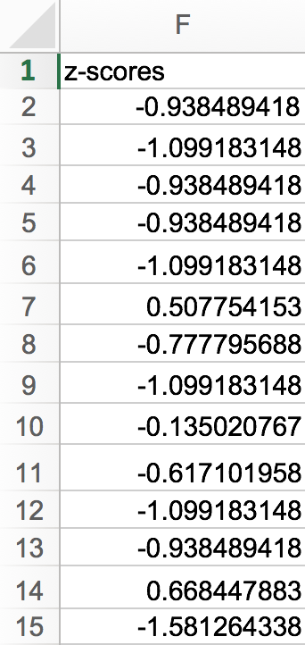
Calculating z-Scores from Raw Scores
Excel includes the following function that converts raw scores to z-scores:
STANDARDIZE(number,AVERAGE(number1,number2,...),STDEV.P(number1,number2,...)). Returns a standardized value.
Enter the following formula in cell F2:
=STANDARDIZE(A2,AVERAGE(A$2:A$170),STDEV.P(A$2:A$170)).
Click on cell F2, hold the Shift key down, and click on cell F170 in order to select the range F2:F170.
Using the Excel Edit menu, select Fill Down. The z-scores are displayed in column F.

Slide 13
Calculating z-Scores from Raw Scores
An alternative method is to use the z-score mathematical formula
Z = (X – x̄)/SD.
First, calculate the c-community mean in cell D2 using the formula
=AVERAGE(A2:A170).
The mean is 28.84.

Slide 14
Calculating z-Scores from Raw Scores
Next, calculate the c-community standard deviation in cell D8 using the formula
=STDEV.P(A2:A170).
The standard deviation is 6.22.

Slide 15
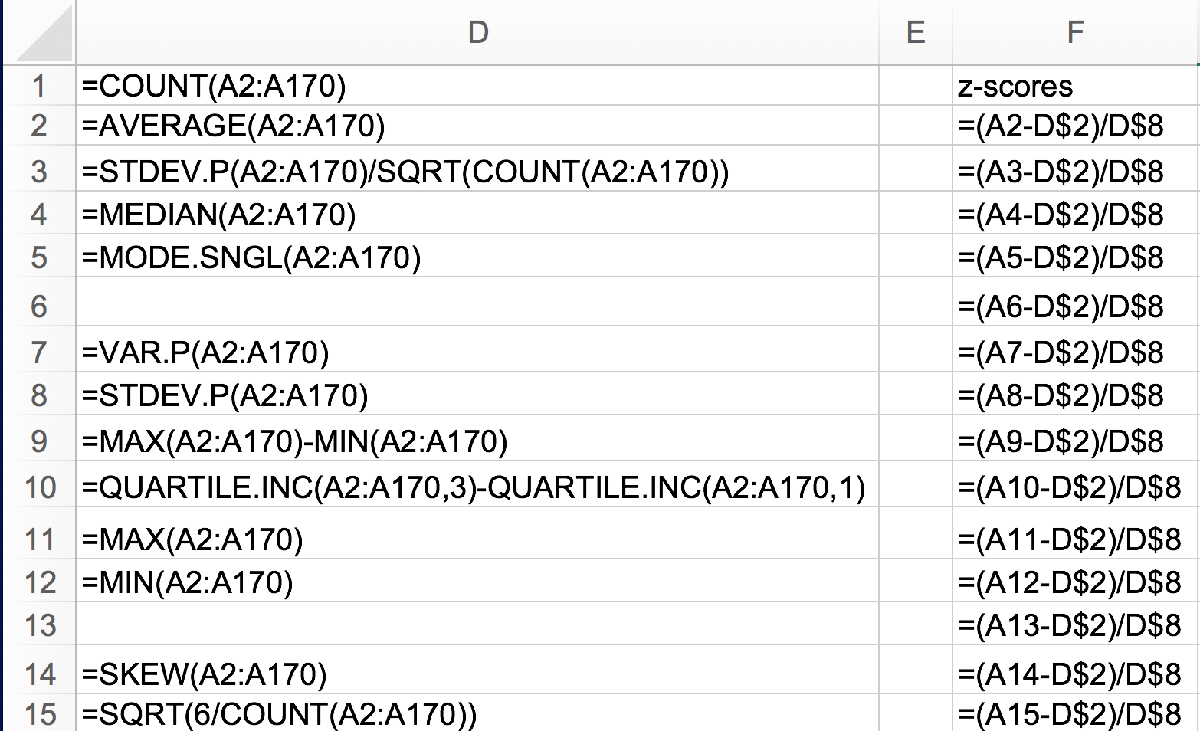
Calculating z-Scores from Raw Scores
Enter the z-score formula in cell F2:
=(A2-D$2)/D$8
Where D2 is the mean and D8 is the standard deviation.
(Note the use of absolute addresses for cells D2 and D8.)
Click on cell F2, hold the Shift key down, and click on cell F170 in order to select the range F2:F170.
Using the Excel Edit menu, select Fill Down. The z-scores are displayed in column F.

Slide 16
Measures of Relative Position
End of Presentation

